Slide 1
WATER LEVEL INDICATOR
Logic implemented by:
21k-3364 Abdul Rehman
21k-4578 Syeda Samaha Batool Rizvi
21k-4897 Laiba Meer

Slide 2
Title and Content Layout with List
Why do we need it?
Introduction
Components used
Specifications
Features
Functionality
Implementation
Testing
application

Slide 3
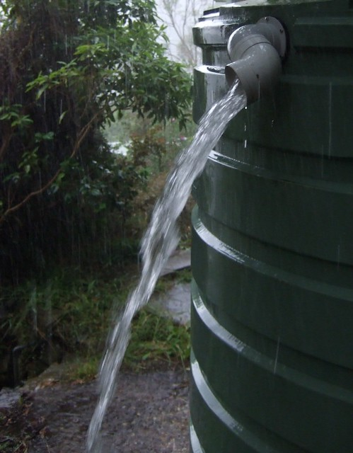
Why we need this?
No indicator
Water overflow
Wastage of water
Shortage of water on large scale

Slide 4
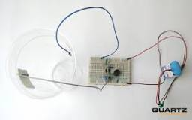
Introduction
Water levels can be measured in a variety of ways. Most common is the use of a reel-mounted electric tape with a water sensitive probe that is lowered into the well and triggers an alarm when it contacts water. These electric tapes are accurate to within 1/100 of a foot.

Slide 5
Components used
555 TIMER IC
BREAD BOARD
BUZZER
CAPACITOR
led
CONNCETING WIRES
BATTERY WITH CONNECTOR
RESISTOR

Slide 6
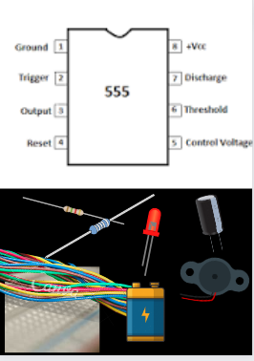
Specification of components
‌555 timer IC – provides the necessary set of pins (SR-flip flop, comparators, and )
‌Buzzer – To alert when the the water container is full (It starts buzzing)
‌Resistors (22K Ohm - 1, 570 Ohm - 1, 1K Ohm - 2) – to control the voltage provided to the circuit (To lower it if High)
‌Capacitors (1 uF – 1) – To store the desired amount of charges required to trigger the circuit
‌Breadboard.
‌Connecting wires. – To connect the all the components
LED – to indicate that the water is about to overflow
‌Battery with Battery Snap Connector.

Slide 7

FEATURES
LED
lights up when the water is very close to being full
BUZZER
automatically starts buzzing when the water reaches the overflowing point.

Slide 8
FUNCTIONALITY
Pin 1 is connected to the ground.
Pin 2 and Pin 6 are shorted and connected to pin 7 through 570 Ohm resistor.
An electrolytic capacitor of 1 uF is connected to pin 6 and Ground.
Pin 3 is connected to the buzzer’s positive terminal,
and the buzzer’s negative terminal is connected to the ground.
Pin 4 is grounded through a 1K Ohm resistor.
VCC (supply voltage) is connected to pin 7 through a 22K Ohm resistor.
Pin 8 is connected to VCC.
One leg of LED is connected to ground through resistor, while the other end is connected to beaker
A connection is taken from pin 4 and VCC is connected to beaker as shown in the figure.

Slide 9
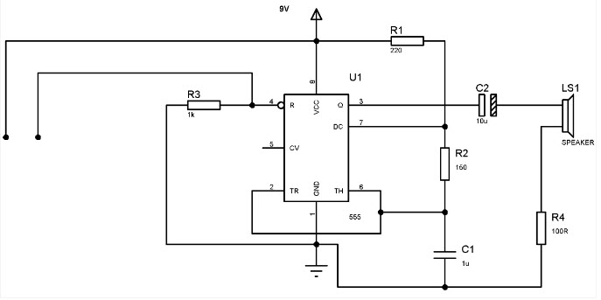
IMPLEMENTAION
For implementing the circuit, we connect it with a battery and connect the wires in water. Now, the circuit is ready for testing. The Circuit will work according to the water level and glows the led when the water level is at a warning stage and buzzers is triggered when it is about to overflow

Slide 10
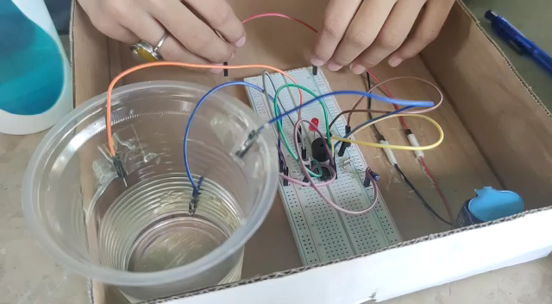
testing
Here is the video to demonstrate the working of our water level indicator

Slide 11
applications
Used in water tanks
Tsunami warning and sea level monitoring
Irrigation control
Oil tank level control
Fuel tank level gauging
Pool water level control

Slide 12

Any questions?

